Slide 1



The history of Artificial intelligent
By Elham Abu Shetayyah

Slide 2

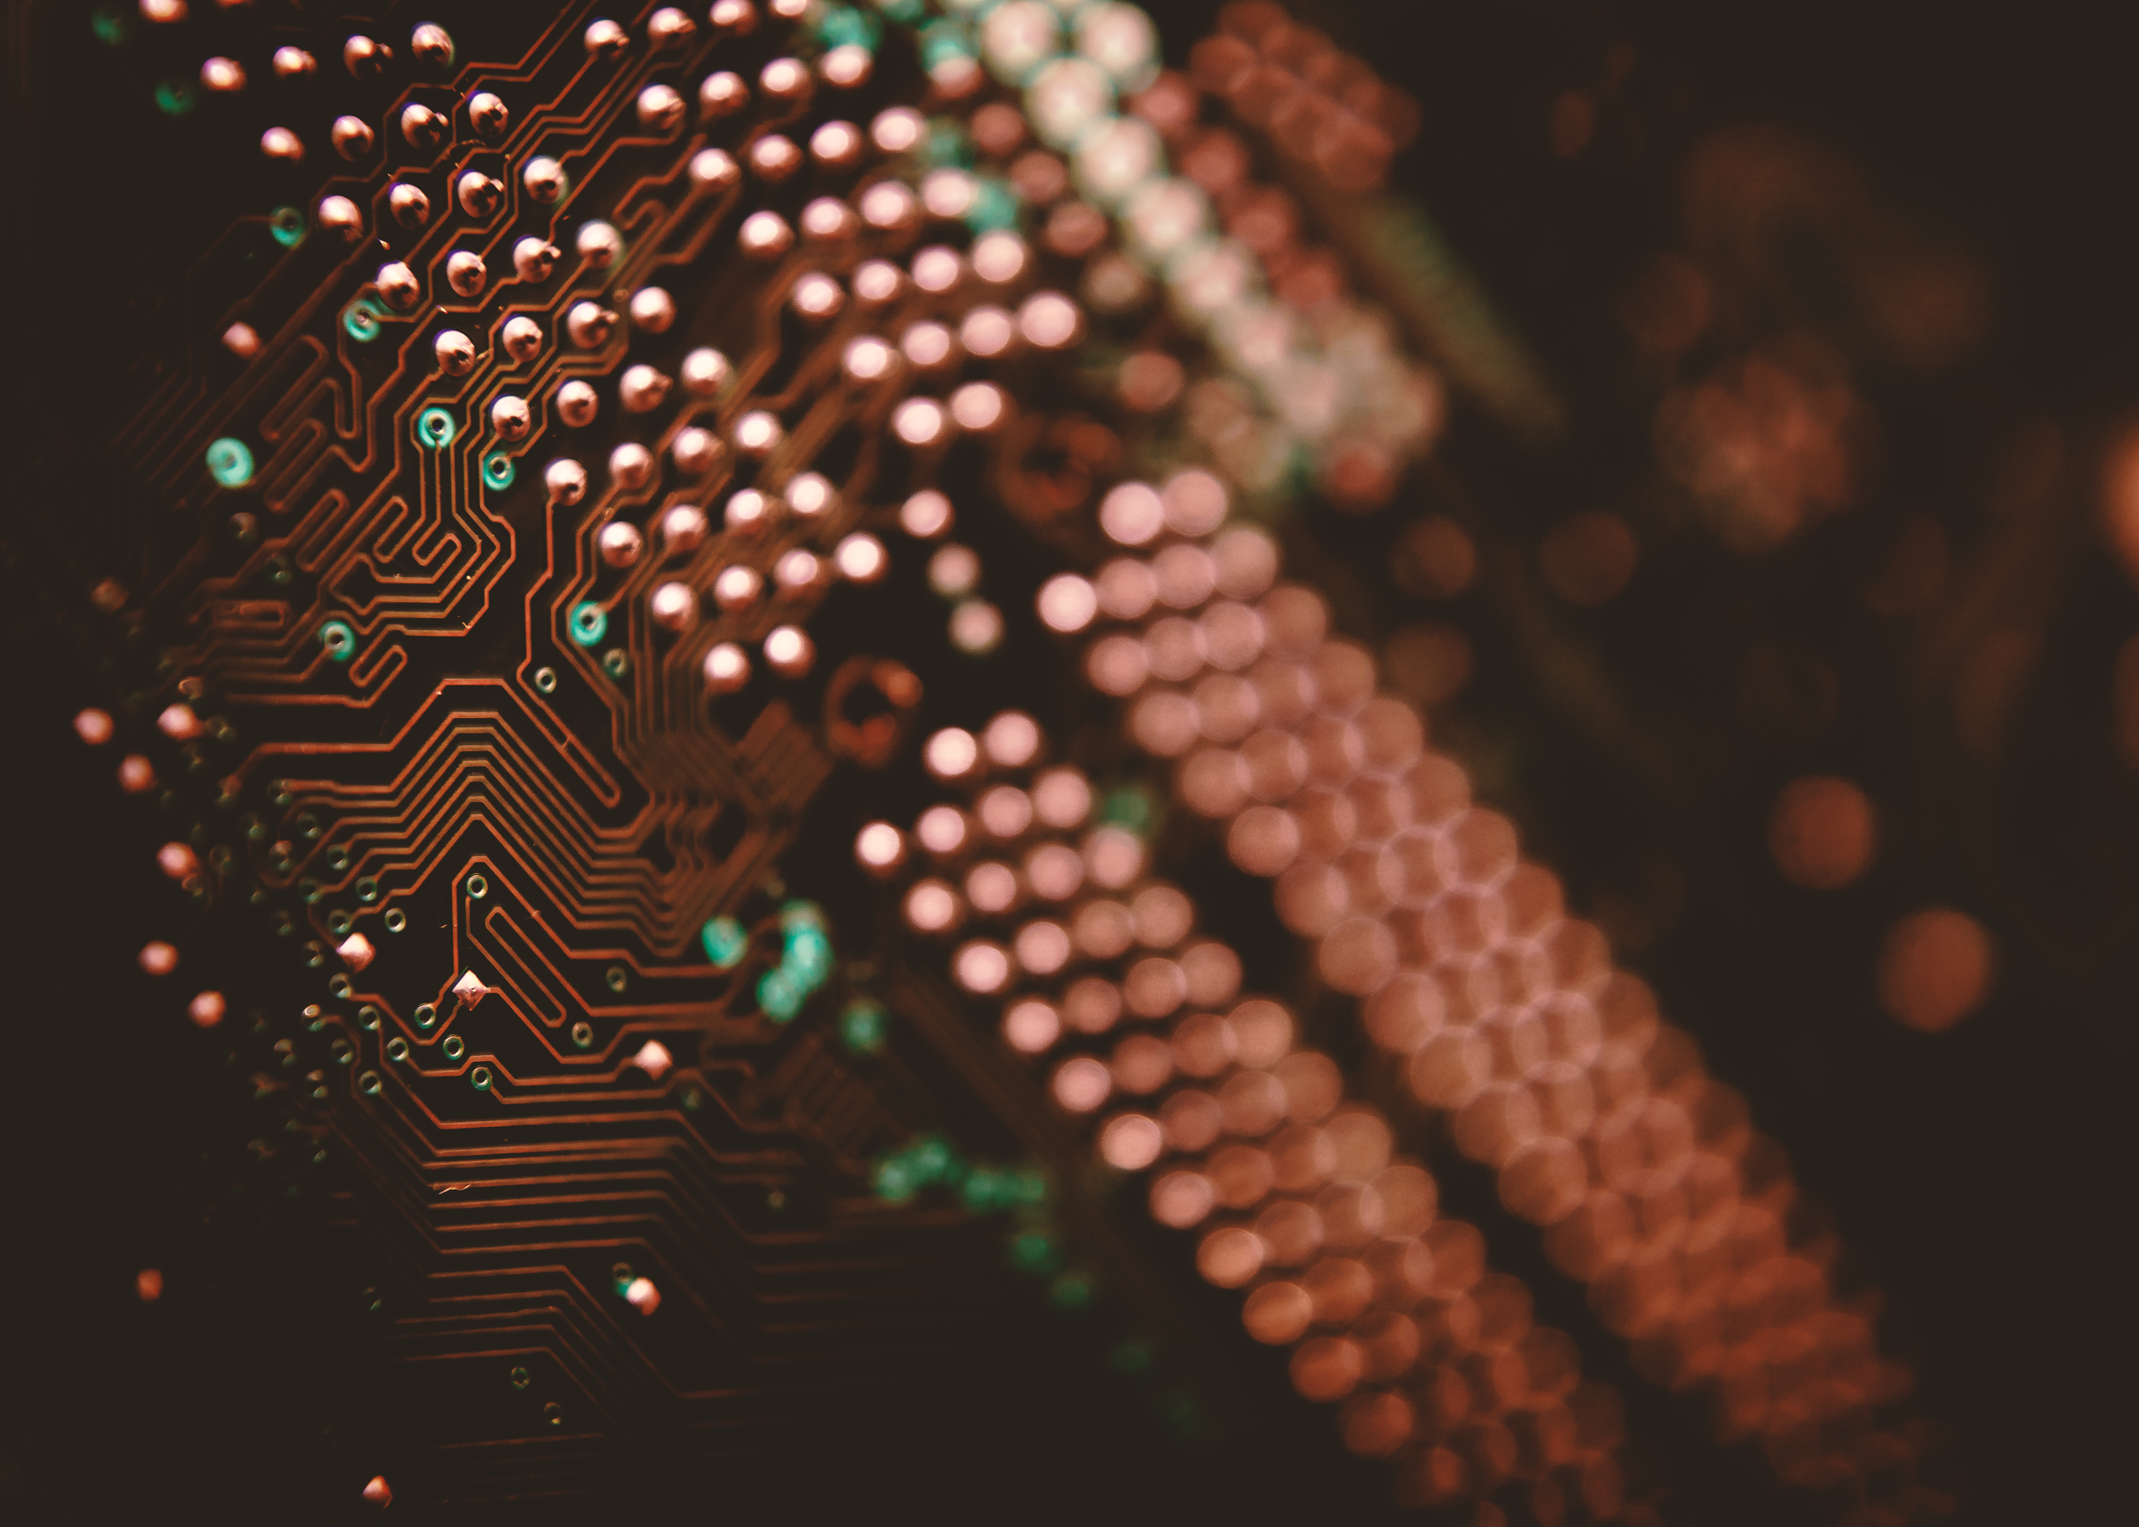
Artificial intelligence is considered as a system that simulates human intelligence and behaves like it to perform some tasks, as it is systems capable of learning and developing itself.
In the beginning, scientists began in the mid-twentieth century to discover some ways to build intelligent machines. Then they established a modern field of research related to artificial intelligence. Then it was funded by the US Department of Defense. Then expert systems succeeded in the eighties, and here was a new decade for the world of artificial intelligence. At the beginning of the twenty-first century, artificial intelligence has been incorporated into medicine, laboratories, logistics, and the technology industry.

Slide 3
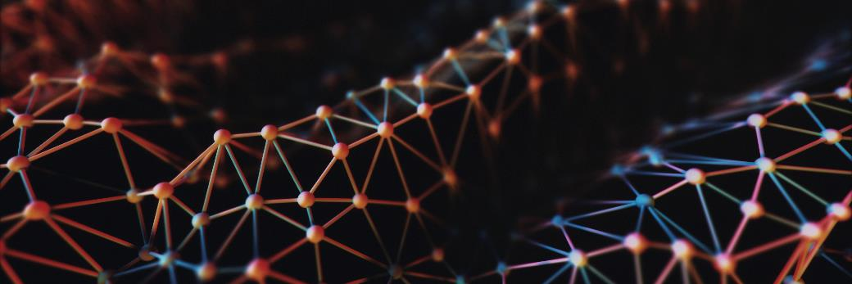
thank you

